Slide 1

Sentimental Dashboard for Tweets
-- with a Demo on political issues
Presented By Daviid Du, Lynn Hong, Ivan Urena-Valdes, Jacky Xie, Willa Yu

Slide 2


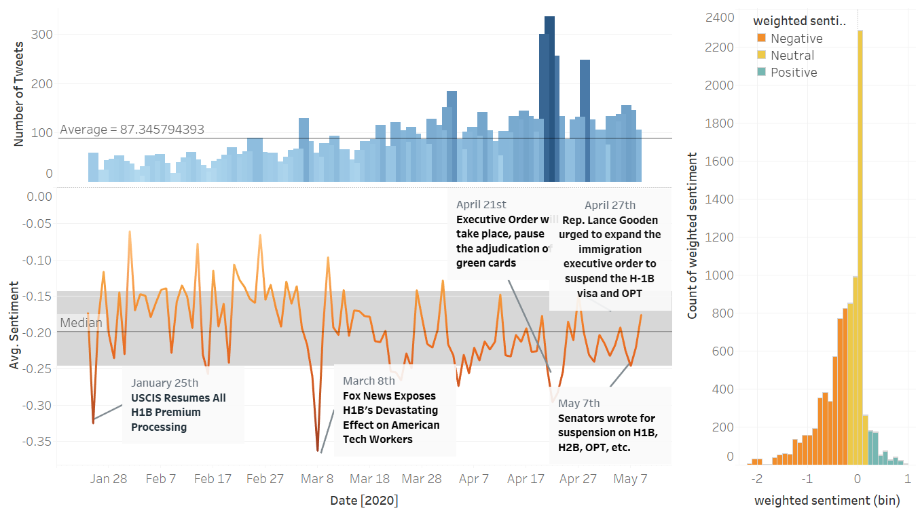
Today’s Topic
Product Overview
Business Model
How does Product work?
Collect and Clean data
GCP NLP API
Demo: #OPT/#H-1B sentiments
Background
Initiative
Functions
Business Value
Sentimental Dashboard for Tweets

Slide 3
Product Overview
Sentimental Dashboard for Tweets
Automatic Dashboard
Get your sentiment report with only a click
Real-time monitor for sentiments
Comprehensive & in-depth visualizations for sentiments

Slide 4
Business Model
Target Customer
Pricing - Subscription-based
Profit
-
Free Trial (7 days)
Monthly Fee ($ 29)
Individuals
Researchers or Investors...
Subscription Revenue
GCP billing
Profit
=
Free Trial (15 days)
Monthly Fee ($ 49+)
Requests #/volume
Business Entity
Political Organization

Slide 5

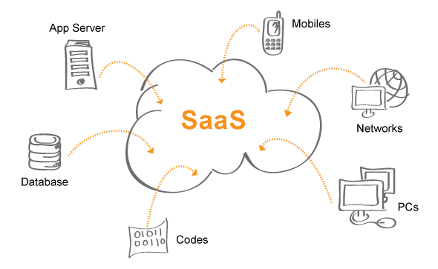

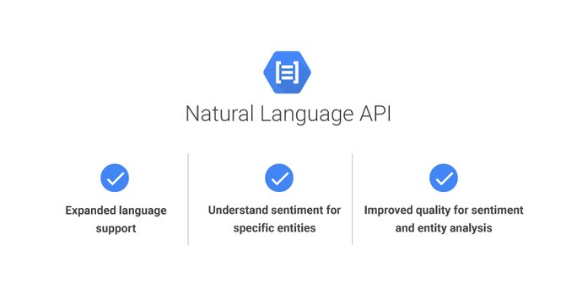
How does it work?
Pick your Twitter #hashtags of interest
Get and clean corresponding tweets
Deploy Cloud Natural Language Processing API
No need for infrastructure or platform
4. Get your Sentimental Dashboard!

Slide 6
Data Collection and Cleaning
Data Source:
tweets scraped from Twitter API- GetOldTweets3
Information:
User info: username, geological location
Tweets info: Hashtags, dates, retweets status, replies, links
Duration:
At least 3 months, to be specified
Cleaning:
Exclude duplicates, keep only English words

Slide 7

Model:
GCP Natural Language Processing API
Utilize pre-trained models of GCP’s Natural Language API for Sentiment Analysis
Two outputs:
Sentiment: between -1 (very negative) and 1 (very positive)
Magnitude: Start from 0

Slide 8
Model:
GCP Natural Language Processing API
Pros
Immediate Deployment
8 Languages Supported
Additional services:
Entity Analysis
Content Classification
Cons
API Limits
1MB Text Content
600 Requests/min
800,000 Requests/day
Low Customizability
Notes:
Natural Language API is simple to program and requires no intensive modeling on our end, which results in immediate deployment of our app(?). It currently supports 8 Languages so it is in no way limited, and can easily be configured to take advantage of other services like entity analysis and content classification. It is, however, limited in its ability to handle requests. While we don’t have extremely high request limits yet, this may become a problem in the future. Since the API is a completely pre-trained model, there is no customizability available.

Slide 9
Product Demo
Political Sentiment Dashboard
Target Audience: Public Relationship
Keyword: ‘#OPT/#H-1B’
Duration: 2020-01-24 ~ 2020-05-11
Use Case Demonstration:
Background and Initiatives
Key Functions:
Overall Sentiment Trend
Overall Sentiment Distribution
Cloudword for different sentiments
Keywords’ sentimemts

Slide 10
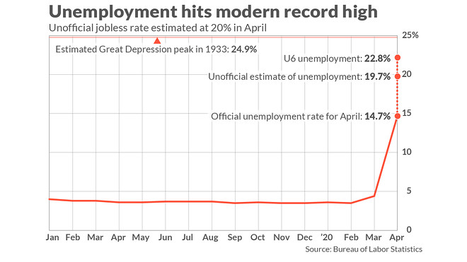
Demo: Political Sentiment #H1b,opt, immigration
USA Covid 19 pandemic
Job market
Notes:
Expert estimate the would unemployment rate would surpass 20%, according to the Washington Post

Slide 11
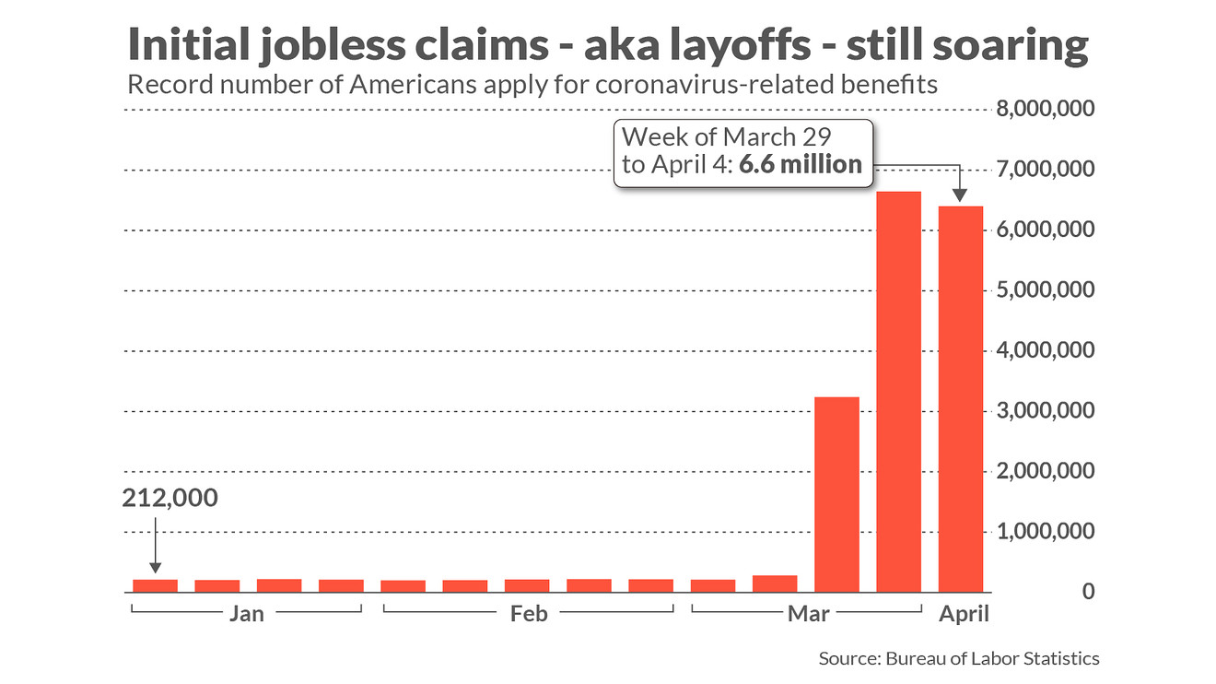
Demo: Initiative
As stock market crash, and many companies are in break-even stage, companies start massive layoff.
“On May 8, four US senators propose to Trump about stop issuing Visa, H1B, H2B for international workers and students."
Since the proposal has not been validate and enact, we want to understand voice on Twitter. What’s the Public’s reactions?
Notes:
Four US senators have urged President Donald Trump to suspend all non- immigrant work permits for at least a year or till employment return to normal.
https://economictimes.indiatimes.com/nri/visa-and-immigration/us-senators-ask-trump-to-suspend-h-1b-for-engineers-ease-rules-for-doctors-nurses-to-fight-covid-19/articleshow/75607341.cms?utm_source=contentofinterest&utm_medium=text&utm_campaign=cppst

Slide 12
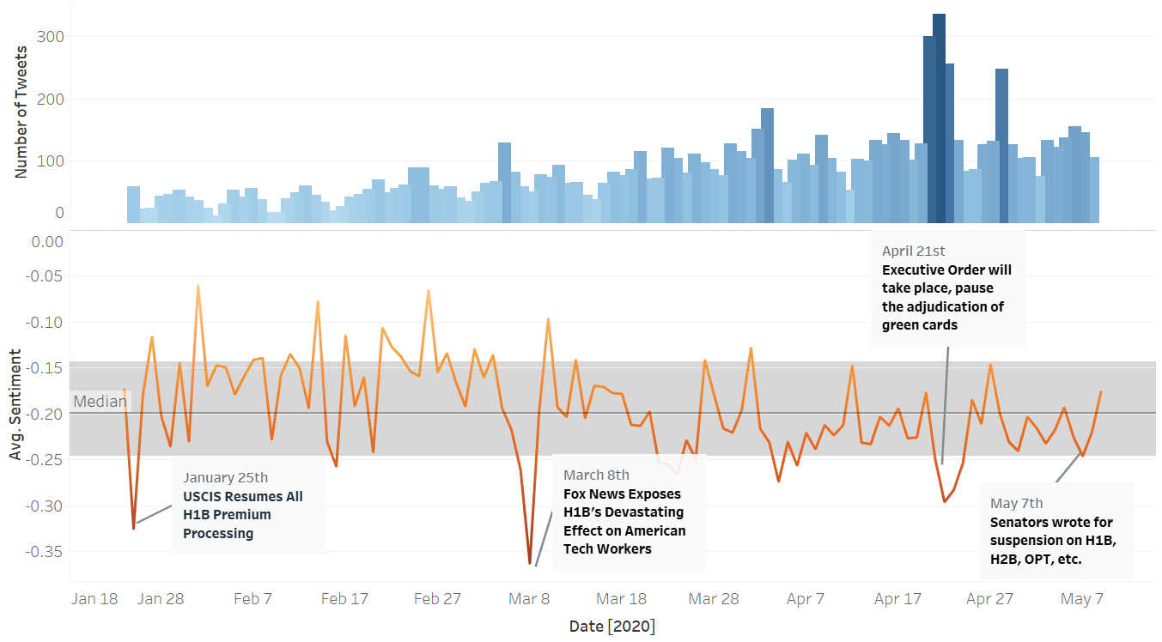
Overall Sentiment Trend
Advantage:
Real-time sentiment trend
Annotated with important news headlines

Slide 13
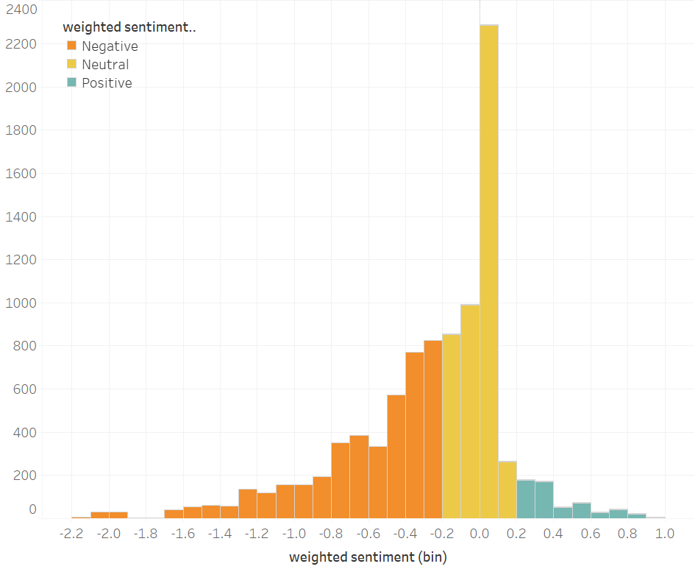
Overall Sentiment Distribution
Use Case:
Help you understand the major sentiments related to your topic
Most people feel negative when discussing about #OPT and #H1B issues.
Weighted Sentiment
= Sentiment * Magnitude
- ∞ ~ -0.2
- 0.2 ~ 0.2
0.2 ~ ∞

Slide 14



Cloudword
Use Case:
Help you understand what do people talk about when talking about your topic
For e-commerce topics, the Cloudword would be more diverse.
E.g.: Negative - Poor shipping
Positive - Good Customer Service
negative
neutral
positive

Slide 15
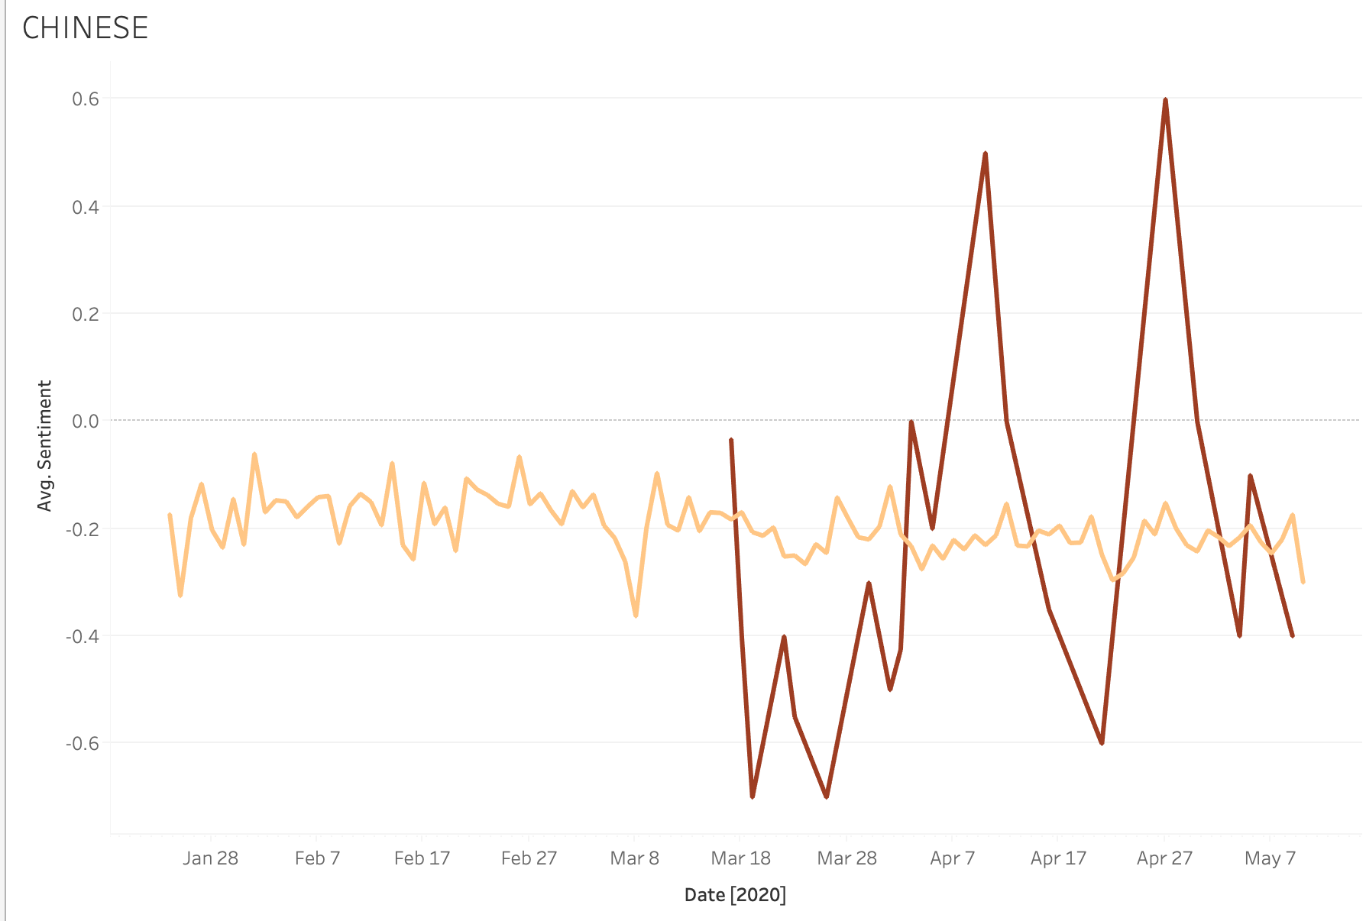
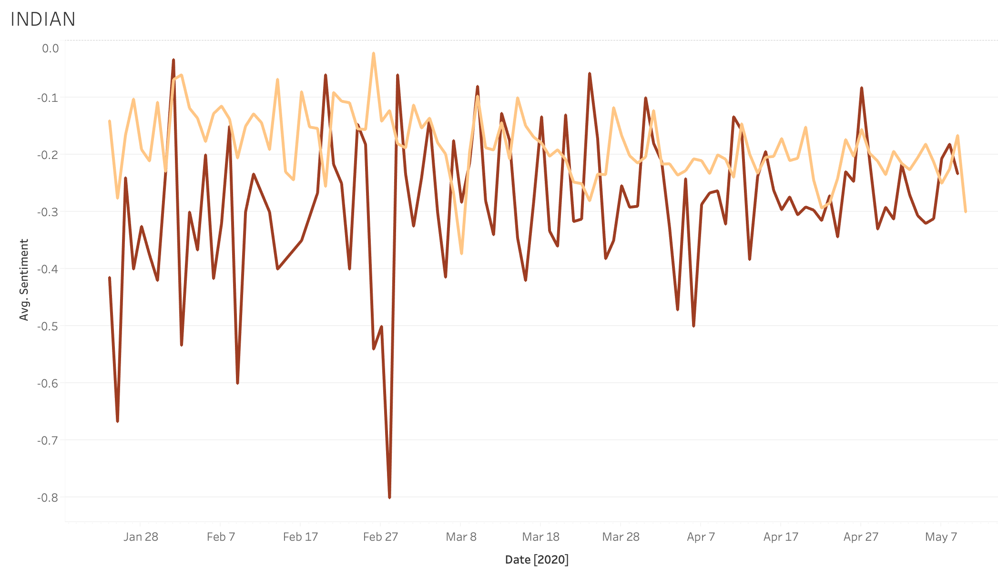
Keywords Sentiment
Use Case:
Specify your sub-level keywords
Compare
Draw insights
People started to talk about ‘Chinese’ on Twitter in a fluctuated attitude after Mar 18th.
When people mentioned ‘Indian’ on Twitter, they are in a completely negative attitude.

Slide 16
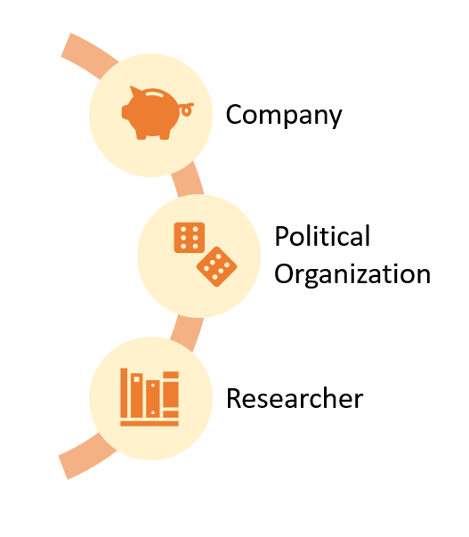

Business Value
Our Product
Comprehensive functions
for sentiment interpretation
Individuals
Notes:
Company
Use Cases: Brand Monitoring, Market Research,
Competitor Analysis
Value: Better understand value propositions;
Gain advantage over your competitor
Political Org
Use Cases: Public opinion monitoring
Value: Know your people, win the poll;
Know people’s responses towards certain executive order
Individual:
Researcher
Use Cases: Sentiment Research
Value: Get real-time sentiment data for research, without the labor of collecting and processing texts
Investor
Use Cases: Stock Market Investment
Value: Predict Stock prices

